Slide 1
Reversible GANs for Memory-efficient Image-to-Image Translation
杜云涛
2021.12.15

Slide 2
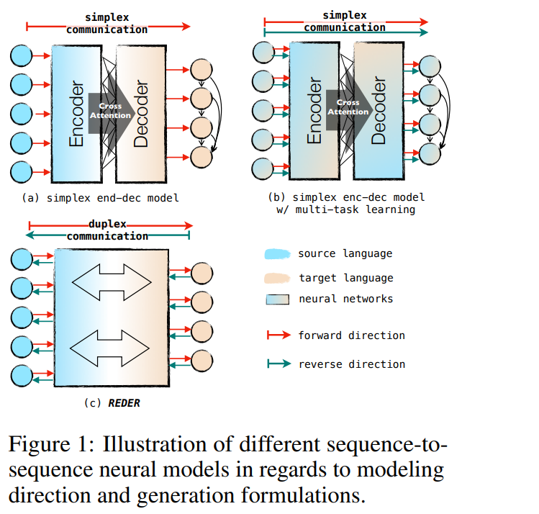
起源
可逆性 (Reversibility)
同质性 (Homogeneity)
理解
中文
英文
生成
Zheng, Zaixiang, Hao Zhou, Shujian Huang, Jiajun Chen, Jingjing Xu and Lei Li. “Duplex Sequence-to-Sequence Learning for Reversible Machine Translation.” NeurIPS 2021.

Slide 3
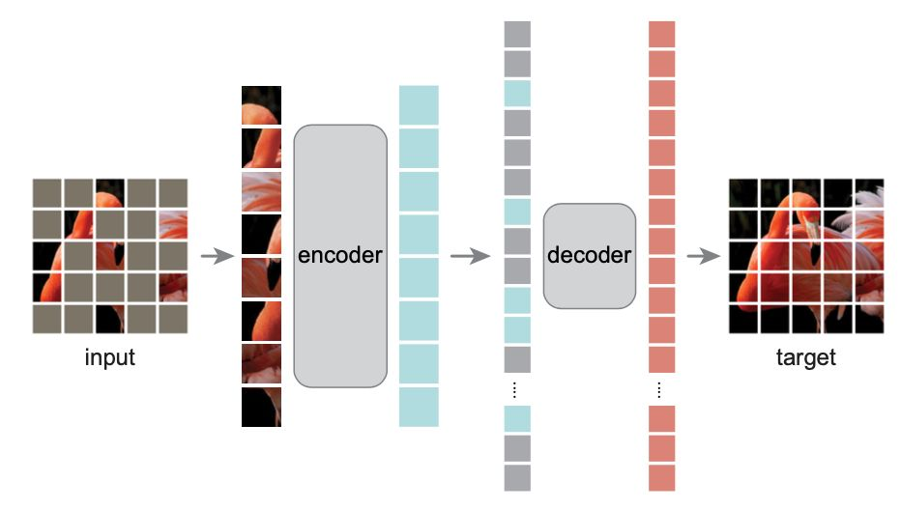
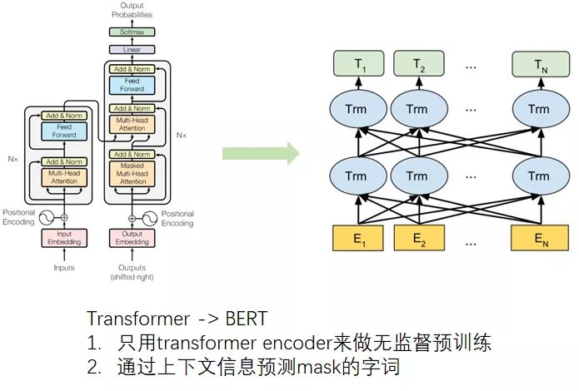
思考
[1] He, Kaiming, Xinlei Chen, Saining Xie, Yanghao Li, Piotr Doll'ar and Ross B. Girshick. “Masked Autoencoders Are Scalable Vision Learners.” ArXiv abs/2111.06377 (2021): n. pag.
[2]Devlin, Jacob, Ming-Wei Chang, Kenton Lee and Kristina Toutanova. “BERT: Pre-training of Deep Bidirectional Transformers for Language Understanding.” NAACL 2019.

Slide 4
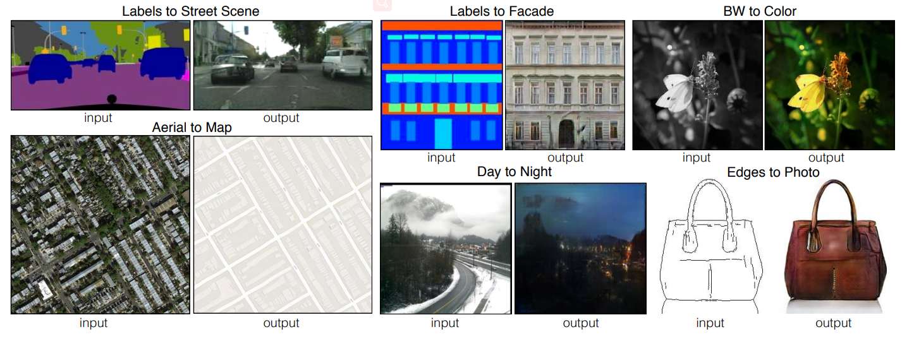
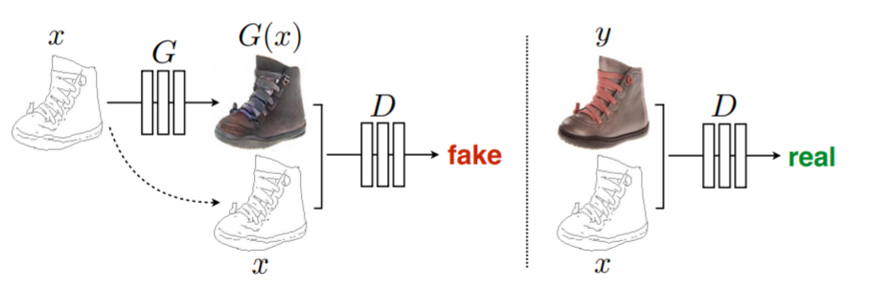
Image-to-Image Translation
Isola P, Zhu J Y, Zhou T, et al. Image-to-image translation with conditional adversarial networks[C] CVPR 2017

Slide 5
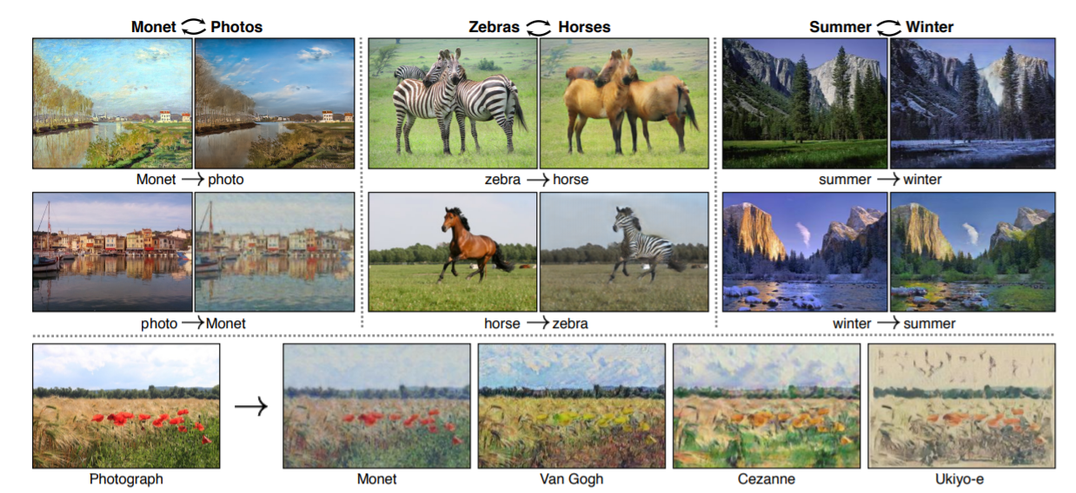
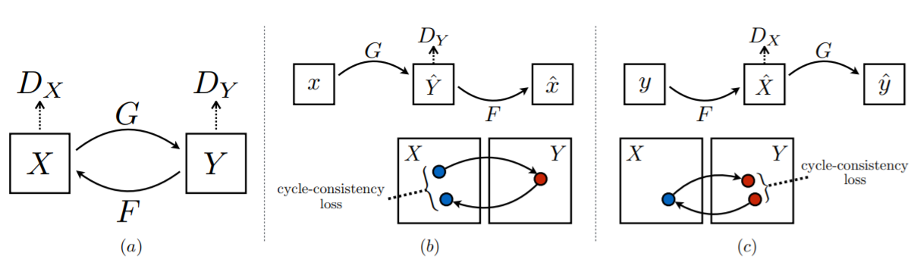
Image-to-Image Translation
Zhu, Jun-Yan, Taesung Park, Phillip Isola and Alexei A. Efros. “Unpaired Image-to-Image Translation Using Cycle-Consistent Adversarial Networks.” ICCV 2017.

Slide 6
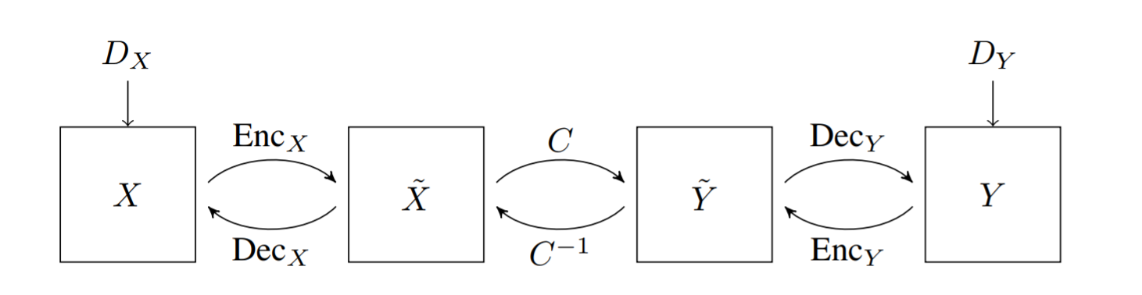
Reversible GANs for Memory-efficient Image-to-Image Translation
隐含着G和F是可逆的
可以只用一个模型
正反向可以同时训练
训练是内存有效的
Ouderaa, Tycho F. A. van der and Daniel E. Worrall. “Reversible GANs for Memory-Efficient Image-To-Image Translation.” CVPR 2019

Slide 7
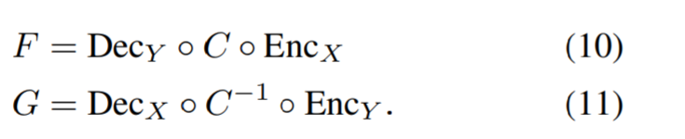
Reversible GANs for Memory-efficient Image-to-Image Translation
Ouderaa, Tycho F. A. van der and Daniel E. Worrall. “Reversible GANs for Memory-Efficient Image-To-Image Translation.” CVPR 2019
Gomez, Aidan N., Mengye Ren, Raquel Urtasun and Roger B. Grosse. “The Reversible Residual Network: Backpropagation Without Storing Activations.” NIPS (2017).

Slide 8
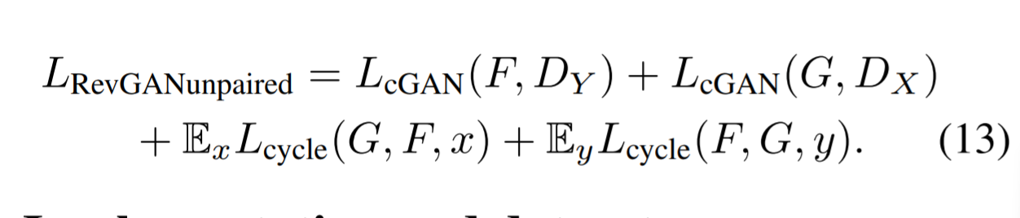
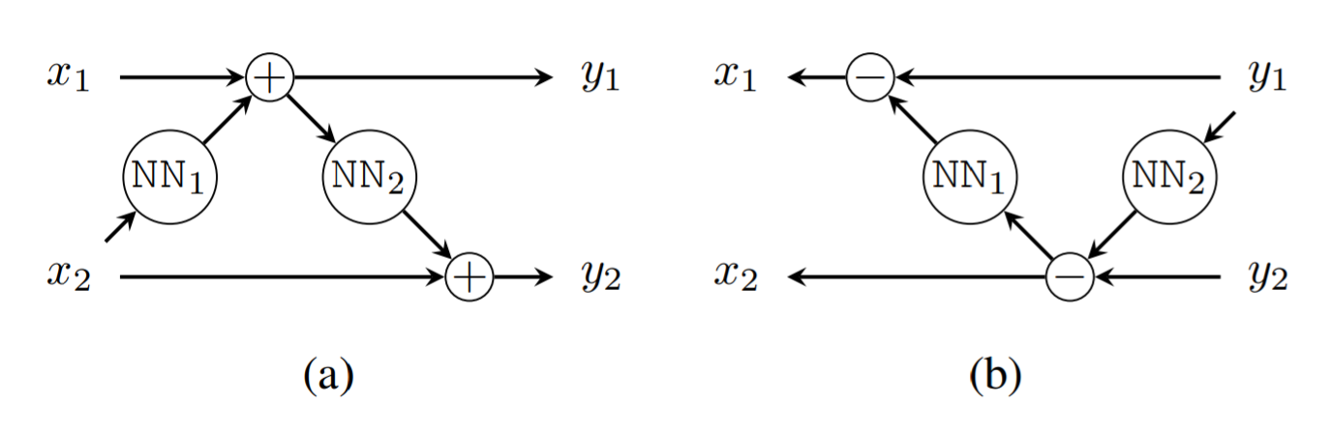
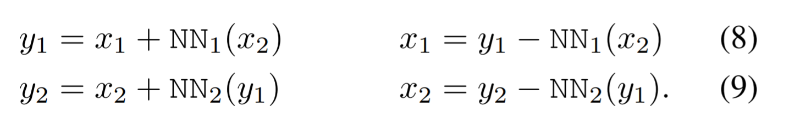
Reversible GANs for Memory-efficient Image-to-Image Translation
将输入x按通道拆分成x1和x2,即x=[x1;x2]
Ouderaa, Tycho F. A. van der and Daniel E. Worrall. “Reversible GANs for Memory-Efficient Image-To-Image Translation.” CVPR 2019
Gomez, Aidan N., Mengye Ren, Raquel Urtasun and Roger B. Grosse. “The Reversible Residual Network: Backpropagation Without Storing Activations.” NIPS (2017).

Slide 9
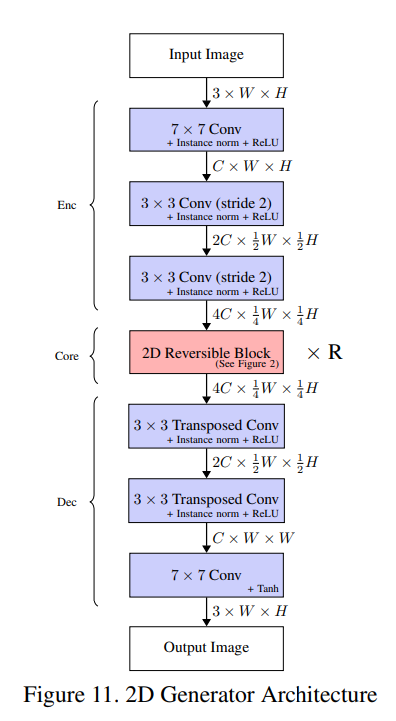
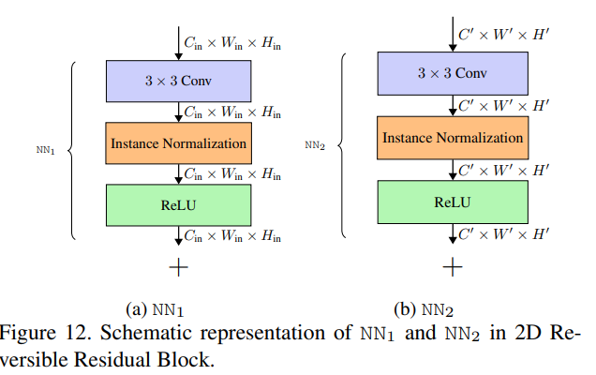
Reversible GANs for Memory-efficient Image-to-Image Translation

Slide 10
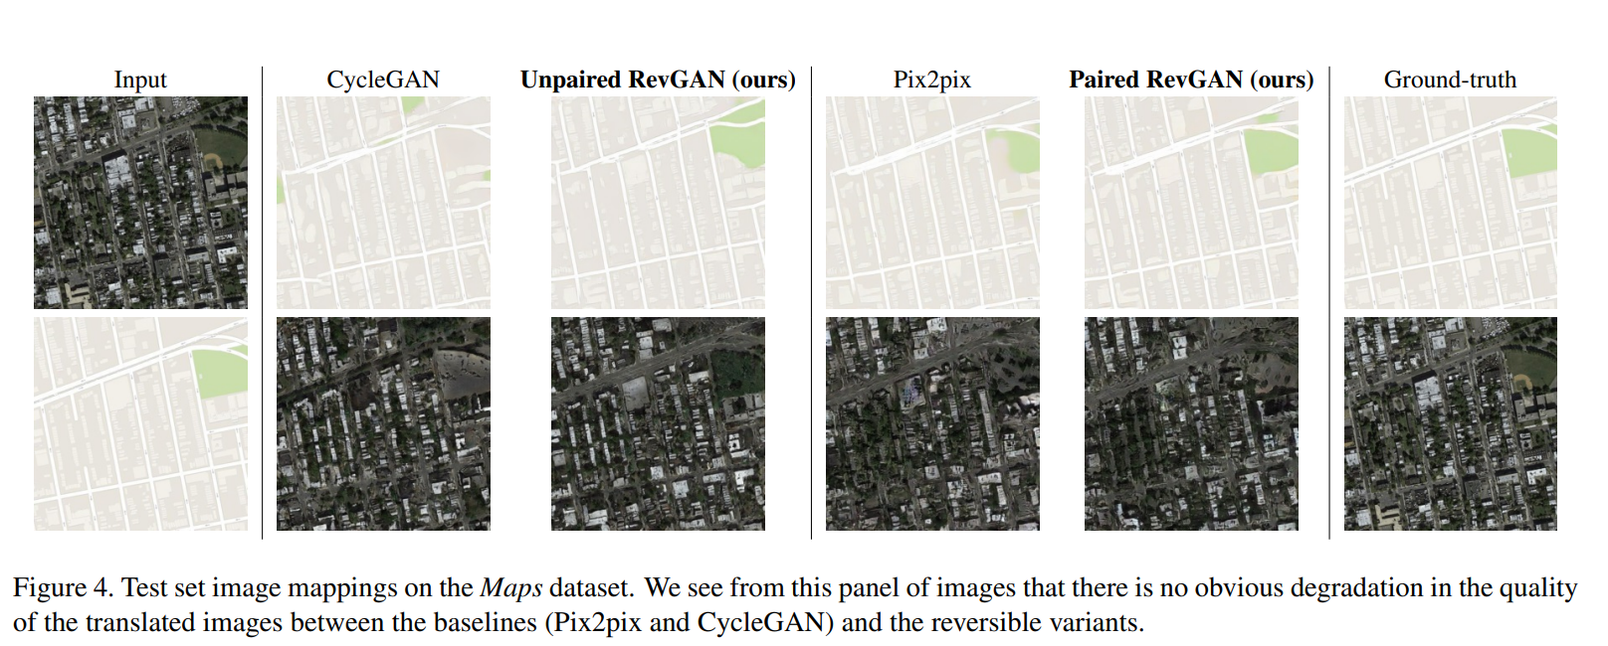
Reversible GANs for Memory-efficient Image-to-Image Translation
Maps The Maps dataset contains 1096 training images and an equally sized test set carefully scraped from Google Maps in and around New York City by [17]. The images in this dataset are downsampled to 256 × 256. We evaluate the outputs with several commonly used metrics for image-quality: mean absolute error (MAE), peak signal-to-noise ratio (PSNR) and the structural similarity index (SSIM)

Slide 11
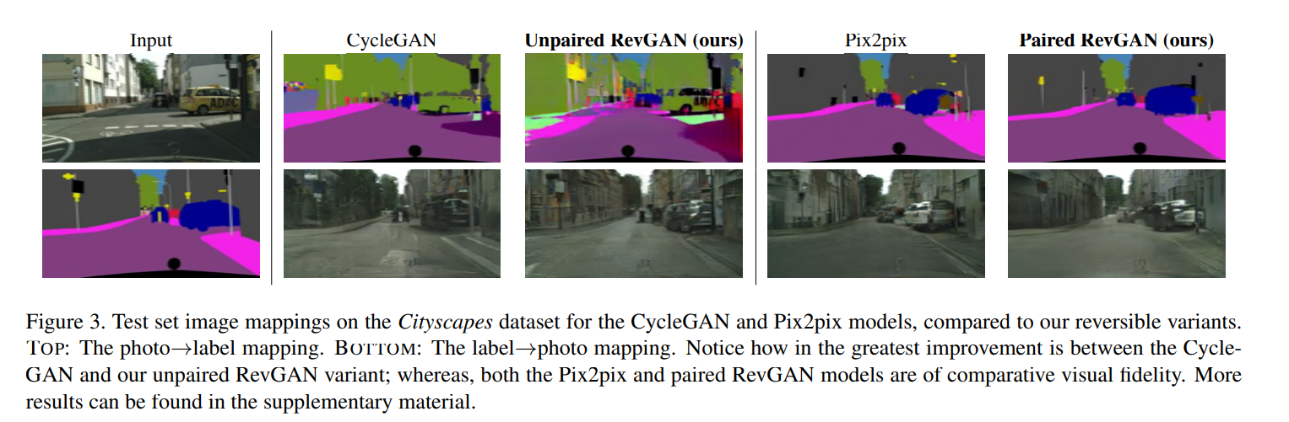
Reversible GANs for Memory-efficient Image-to-Image Translation

Slide 12
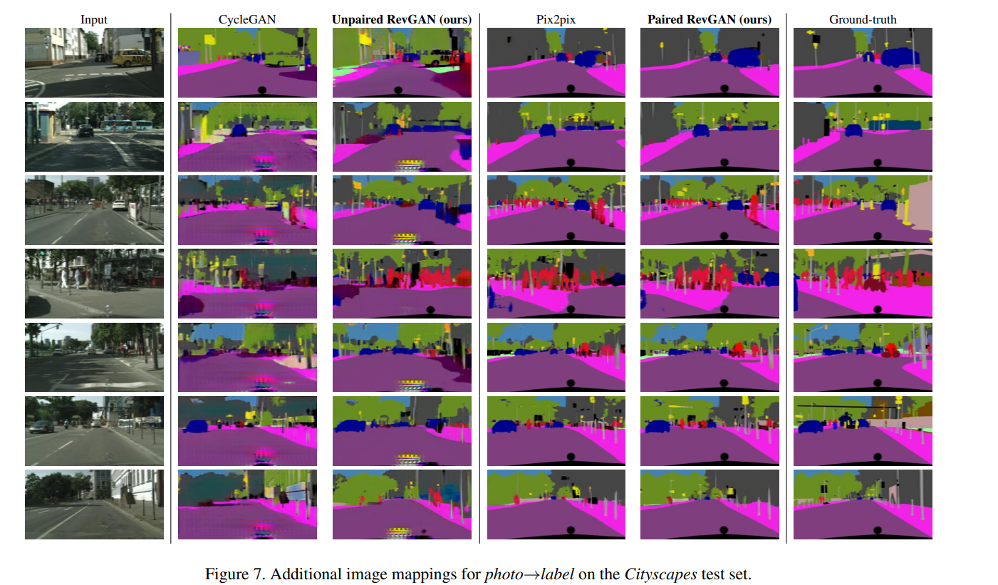
Reversible GANs for Memory-efficient Image-to-Image Translation

Slide 13
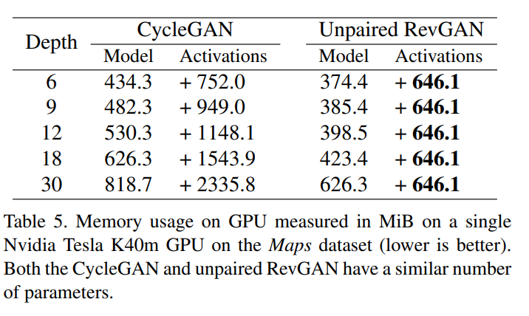
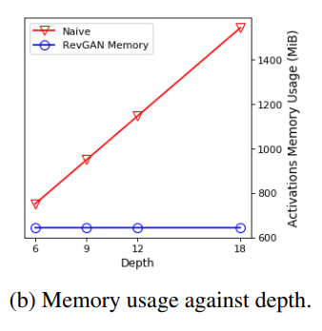
Reversible GANs for Memory-efficient Image-to-Image Translation

Slide 14
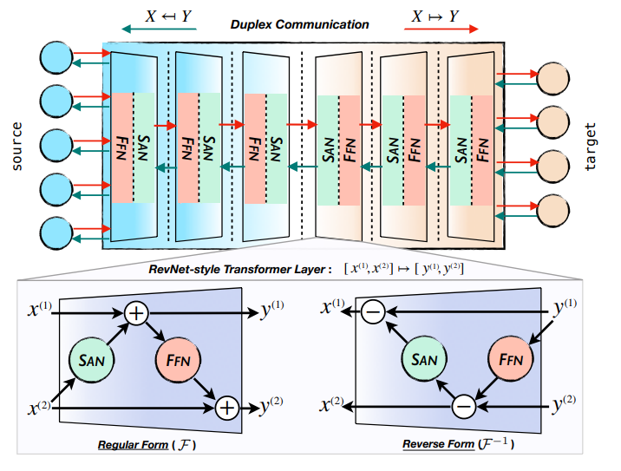
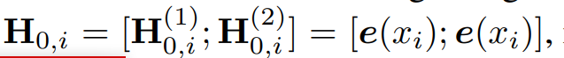
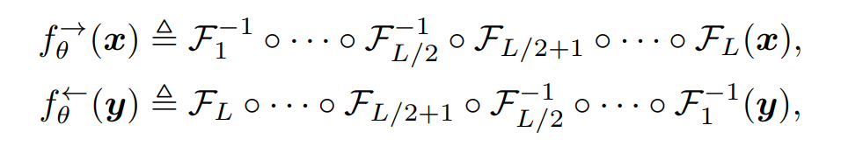
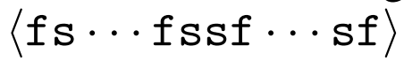
Duplex Sequence-to-Sequence Learning for Reversible Machine Translation

Slide 15
总结
1.对于文本or图像，都可以存在一个双向翻译模型，通过借助可逆神经网络，可以用一个模型实现双向翻译的任务。
2.双向翻译模型可以使得两个方向相互促进且内存有效

